Slide 1
Top 3 Tourism Places in Indonesia
By JOELwindows7 (Joel Robert Justiawan)

Slide 2
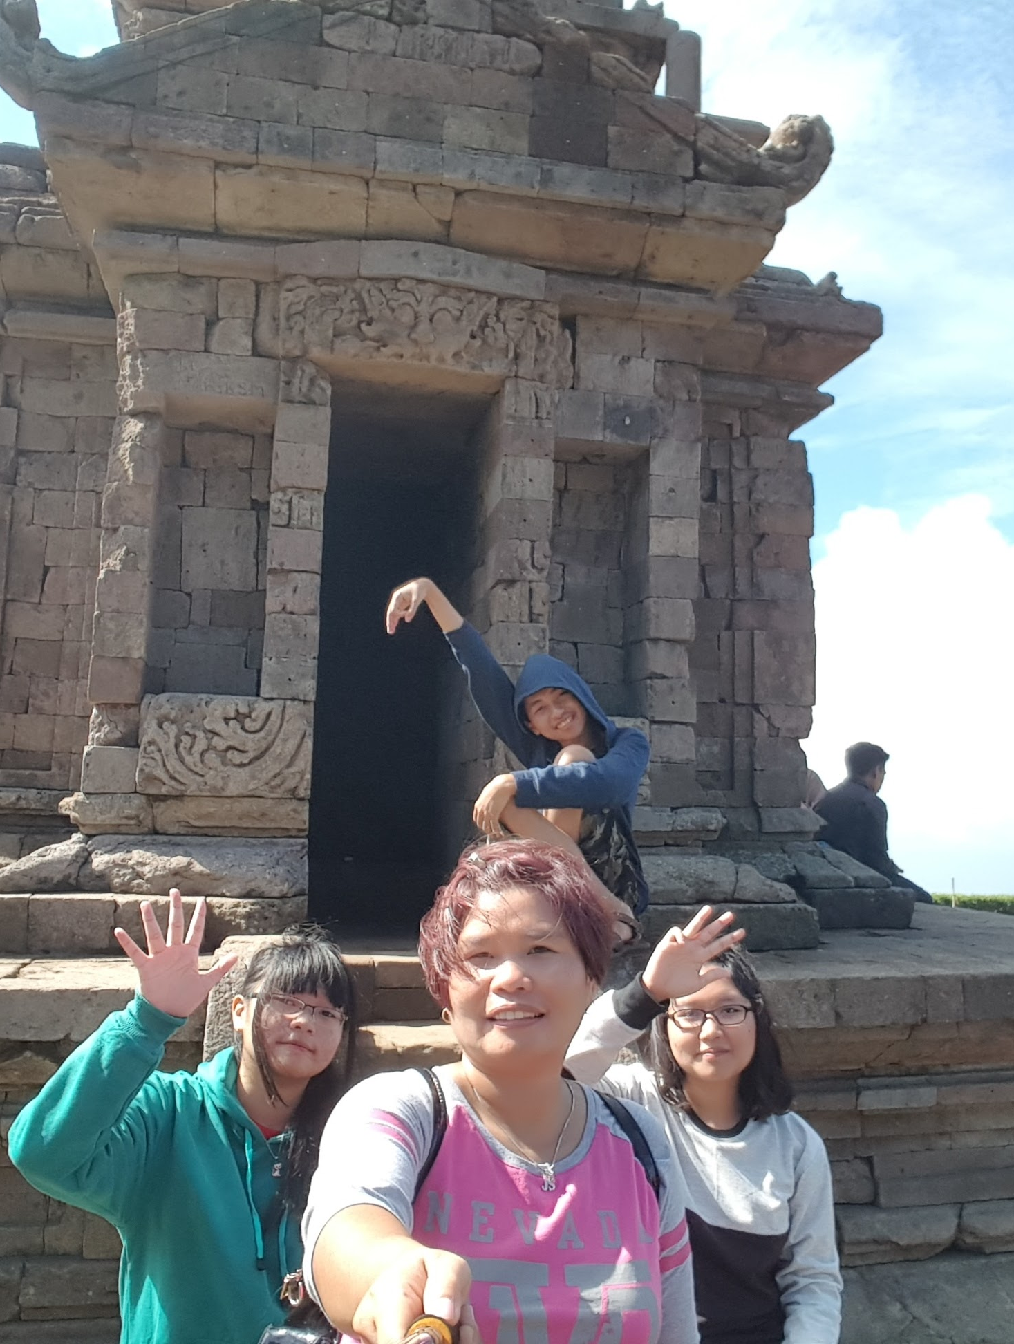
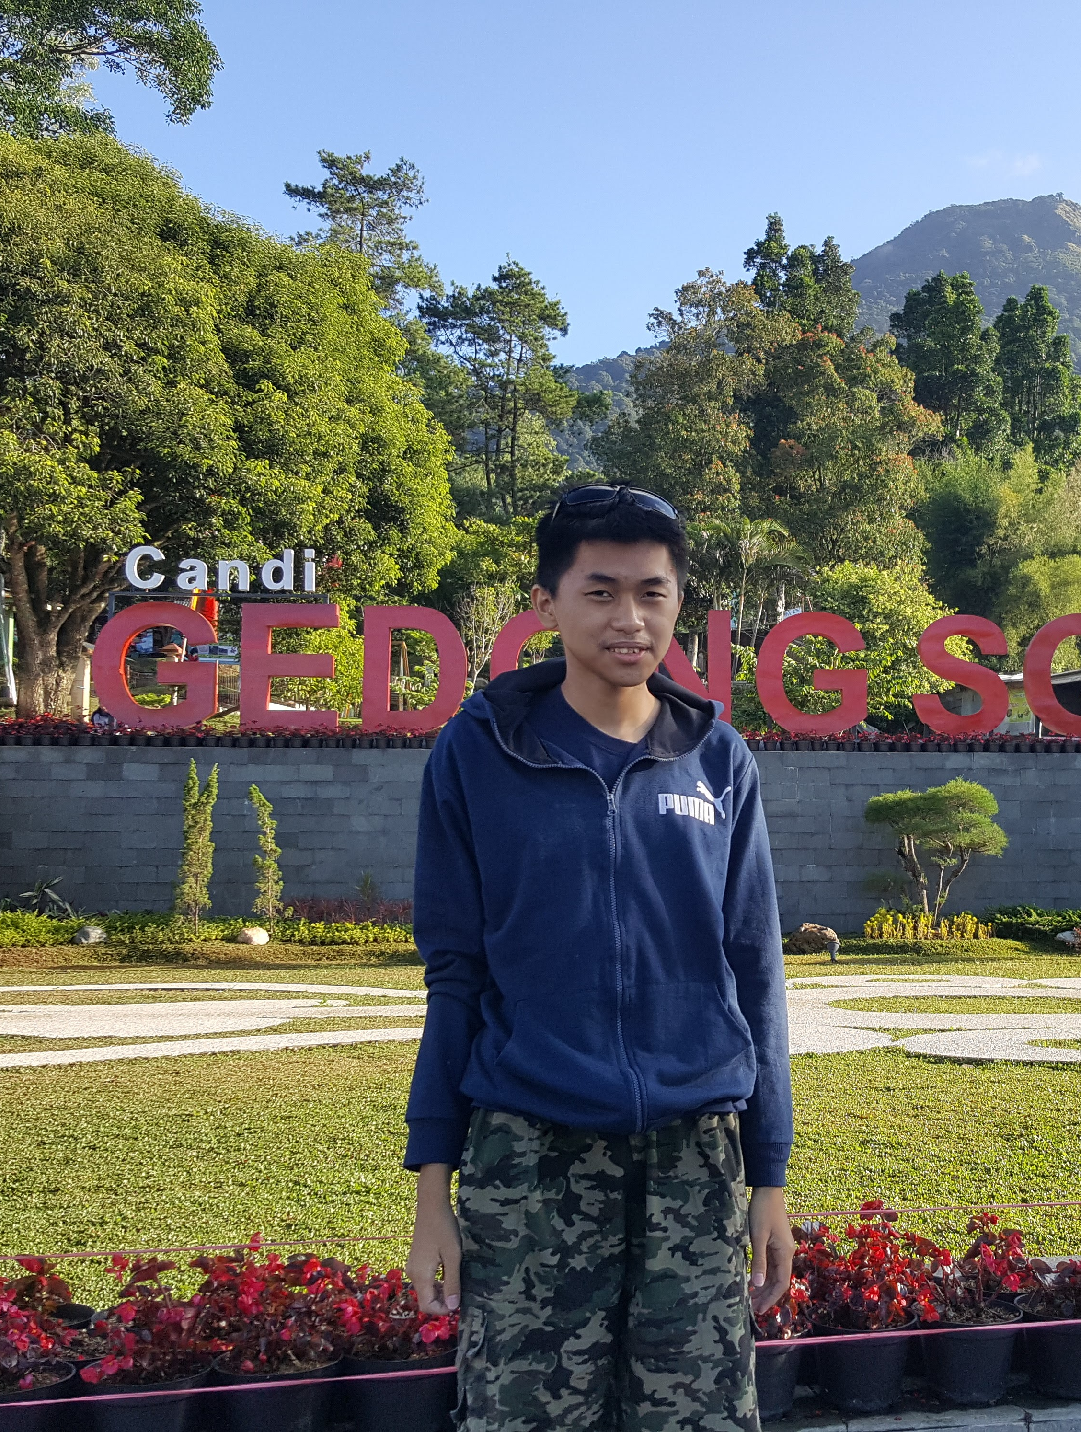
1. Gedung Songo (Nine temples)
Located in Semarang
On a high land, exactly a mountain
Fresh and cool air
Many plants especially trees
Each temples are separated and meters away from first to ninth
Requires sufficient physical conditions to encounter all 9 temples

Slide 3
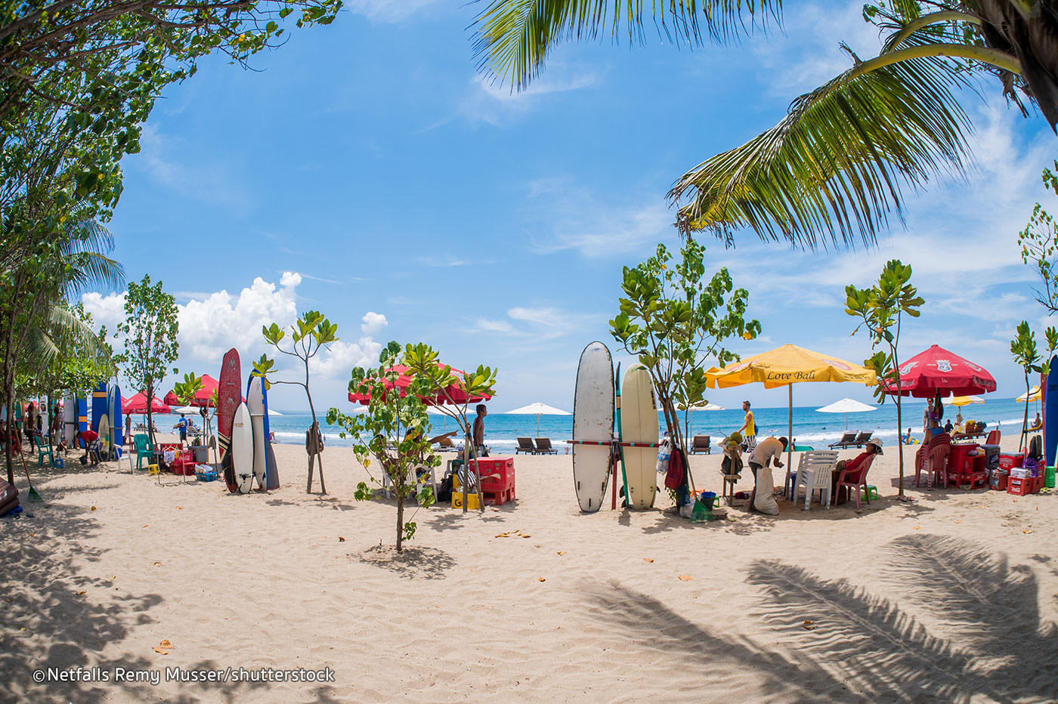
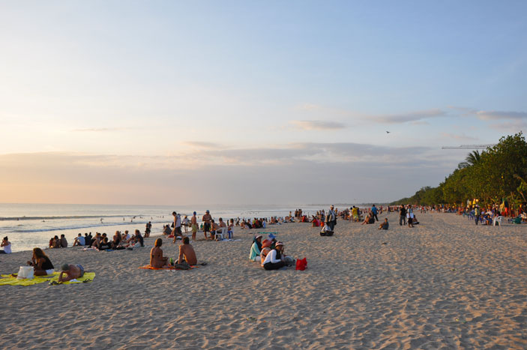
2. Kuta Beach, Bali
With white sands
Moderate waves
Long beach line
Clean, hygienist, to ensure best experiences

Slide 4
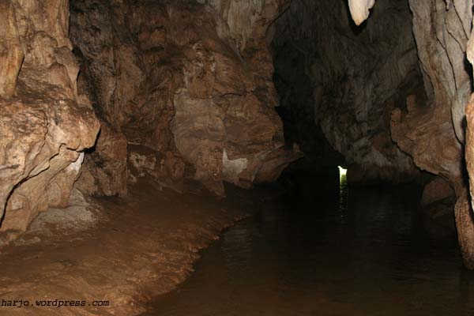
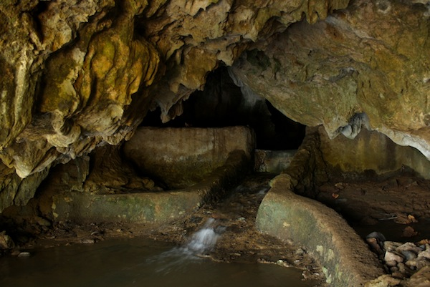
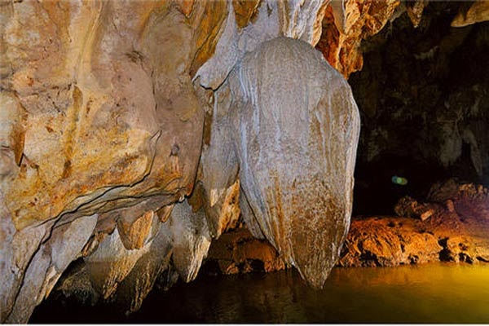
3. LalaY cave, Sawarna
Aesthetic and various shaped stalagmites and stalactites along each caves
Requires sufficient courage, due to low light, some knee heighted flood
Still a pure cave
Bats lives there

Slide 5
End
These are just to name few. Thank you

Slide 6
Image Source
Gedung Songo (The Nine Temples):
Personal documentation
The Kuta Beach:
http://static.asiawebdirect.com/m/bangkok/portals/bali-indonesia-com/homepage/kuta-beach/attractions/allParagraphs/BucketComponent/ListingContainer/01/image/kuta-beachsurf-board.jpg
https://www.bali.com/media/image/285/bali-kuta-beach-sunset-atmosphere.jpg
Sawarna’s Lalay cave:
https://harjo.files.wordpress.com/2011/02/sawarna_img_3946a.jpg
http://www.klikhotel.com/blog/wp-content/uploads/2014/08/goa-lalay.jpg
http://2.bp.blogspot.com/-CRgdGl9uEi0/UwWd8UkSvyI/AAAAAAAABQE/Meq6SkweRsg/s1600/GOA+LALAY.jpg

